Slide 1
Programming II
(C Programming Language)
C Operators
Lecture 3, Monday February 01, 2021
Dr. Ayman ALJARBOUH

Slide 2
Outline
Arithmetic Operators
C Increment and Decrement Operators
C Relational Operators
C Logical Operators
C Bitwise Operators
C Assignment Operators
Precedence and Associativity of Operators in C

Slide 3
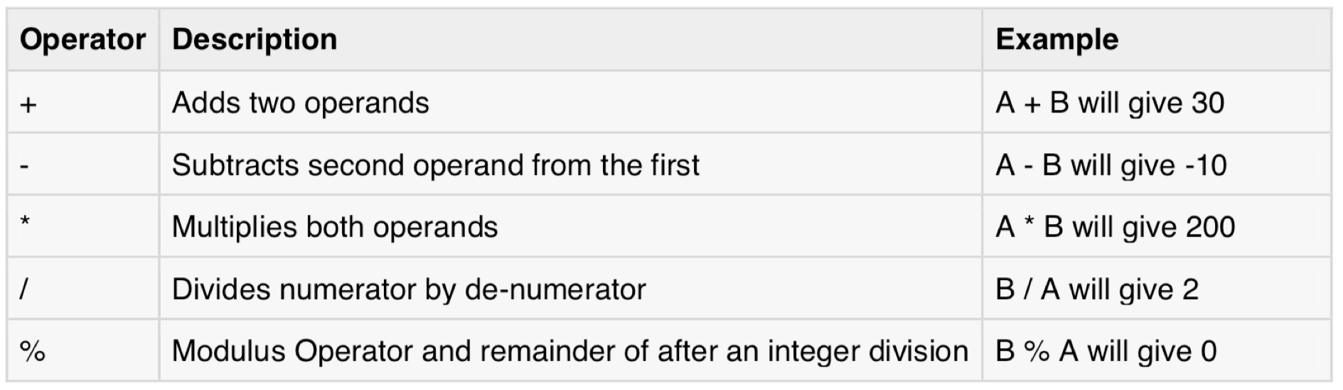
Arithmetic Operators
The following table shows all the arithmetic operators supported by C language
Assume variable A holds 10 and variable B holds 20:

Slide 4
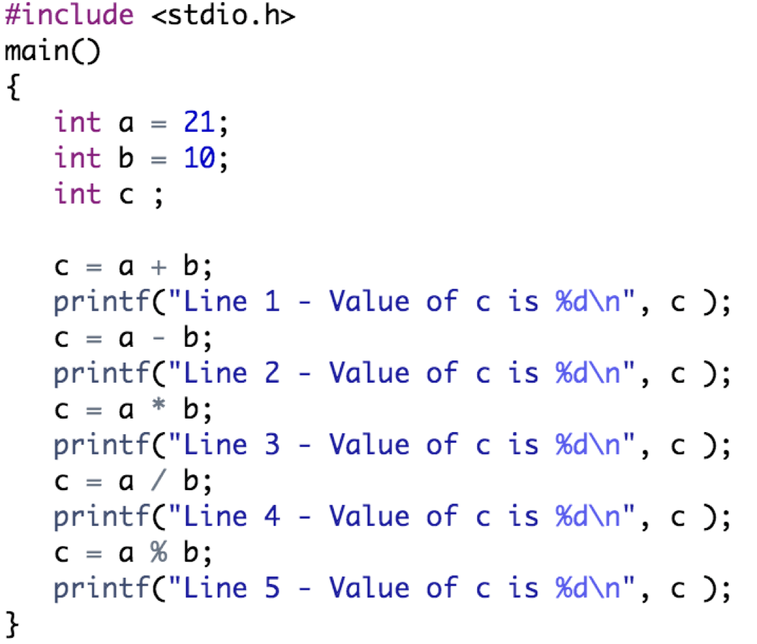
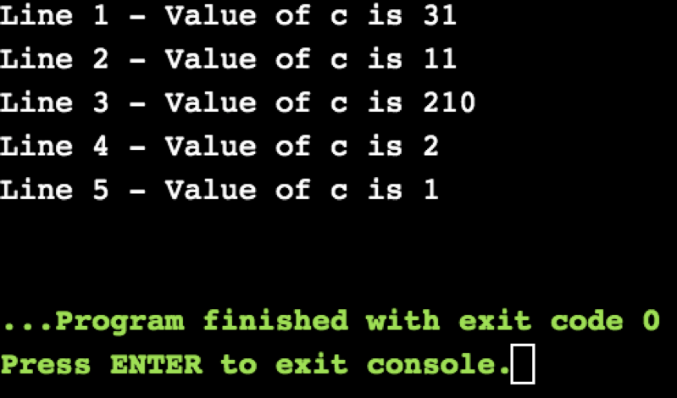
Arithmetic Operators
Output:
Example:
In normal calculation, 21/10 = 2.1. However, the output is 2 in the program. It is because both the variables a and b are integers. Hence, the output is also an integer.

Slide 5
Arithmetic Operators
Output:
Example:
The modulo operator % computes the remainder. When a=21 is divided by b=10, the remainder is 1. The % operator can only be used with integers.

Slide 6
Outline
Arithmetic Operators
C Increment and Decrement Operators
C Relational Operators
C Logical Operators
C Bitwise Operators
C Assignment Operators
Precedence and Associativity of Operators in C

Slide 7
C Increment and Decrement Operators
C has two operators increment ++ and decrement -- to change the value of an operand (constant or variable) by 1
Increment ++ increases the value by 1 whereas decrement -- decreases the value by 1
If ++ is used as prefix (e.g. ++a)., then the value of a is incremented by 1 then it returns the value
If ++ is used as postfix (e.g. a++)., then the value of a is returned first then a is incremented by 1
For example, let a = 5, then:
++a returns: a = 6
--a returns: a = 4
a++ returns: a = 5
a-- returns: a = 5

Slide 8
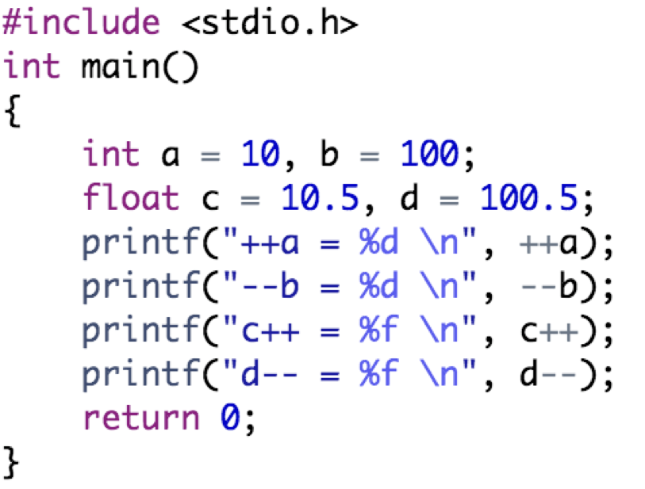
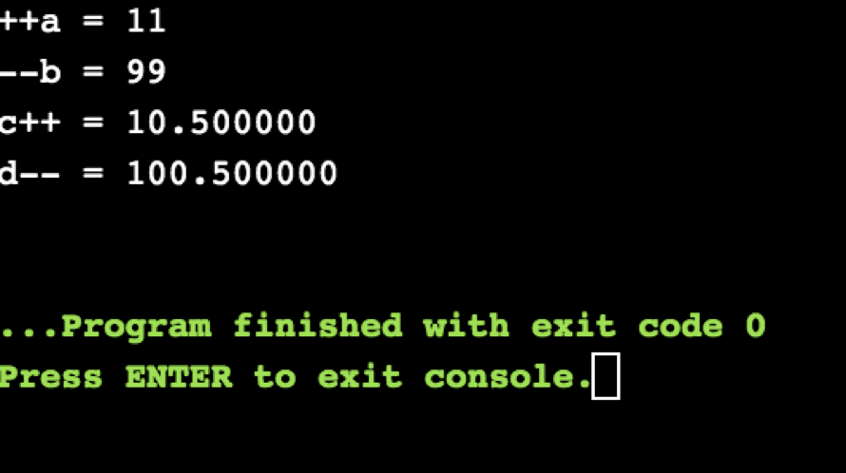
C Increment and Decrement Operators
Output:
Example:

Slide 9
Outline
Arithmetic Operators
C Increment and Decrement Operators
C Relational Operators
C Logical Operators
C Bitwise Operators
C Assignment Operators
Precedence and Associativity of Operators in C

Slide 10
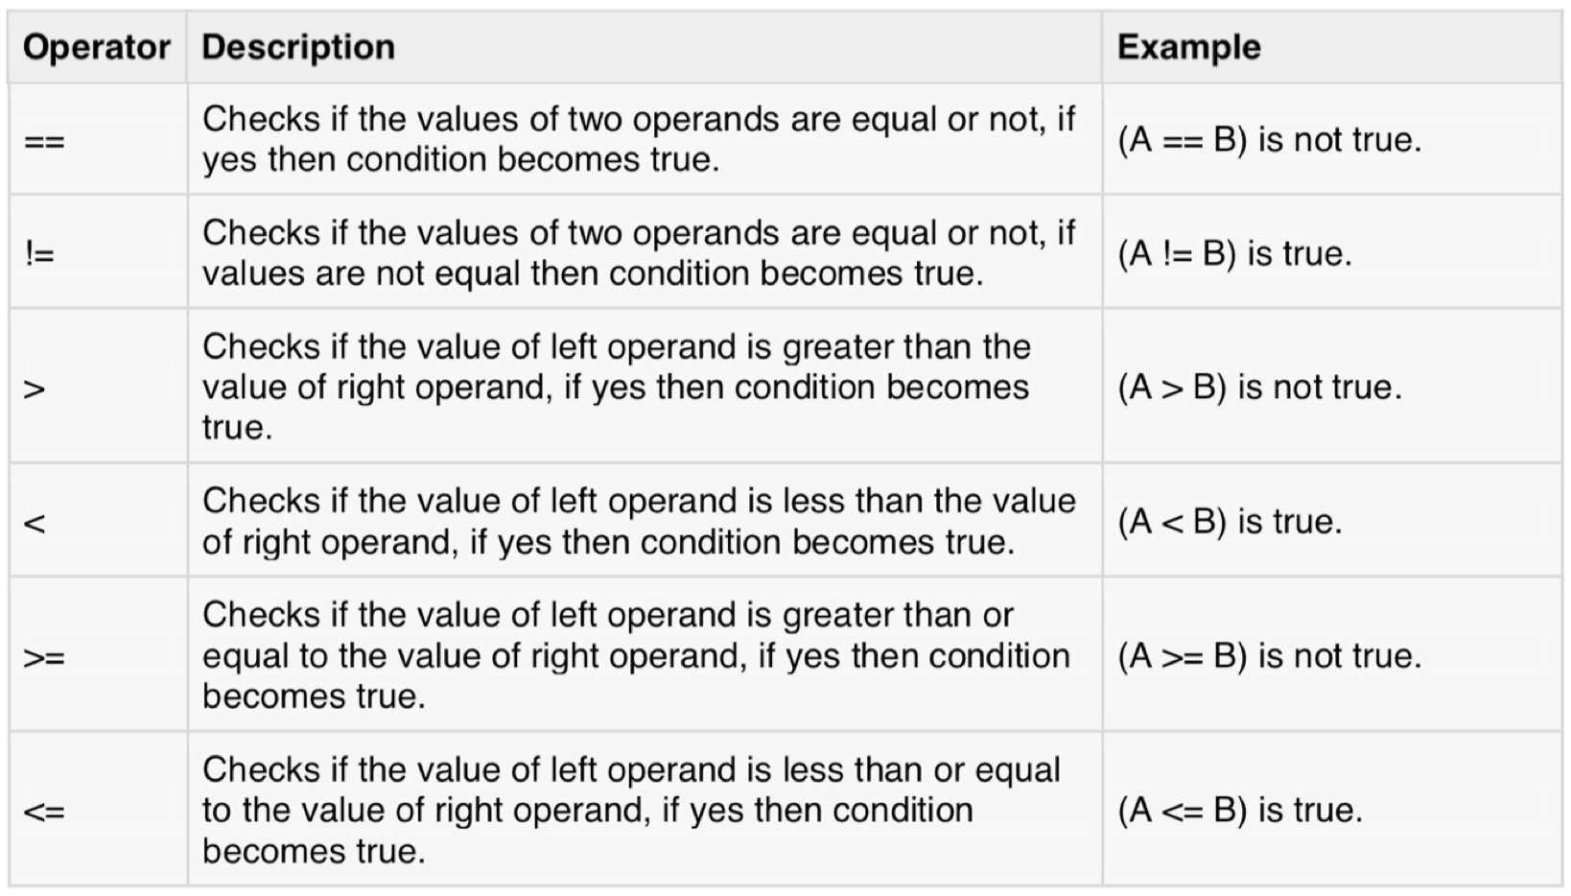
C Relational Operators
The following table shows all the relational operators supported by C language. Assume A holds 10 and variable B holds 20:

Slide 11
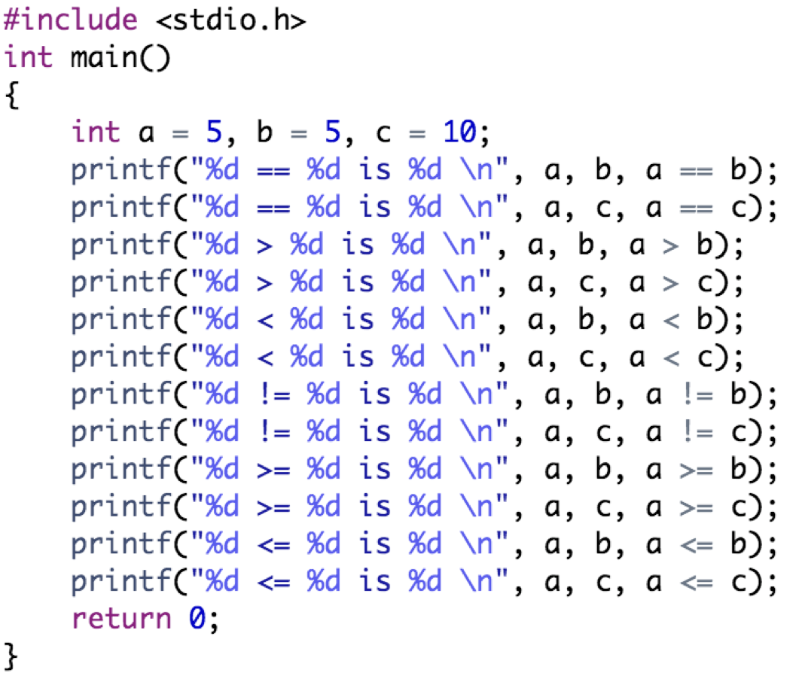
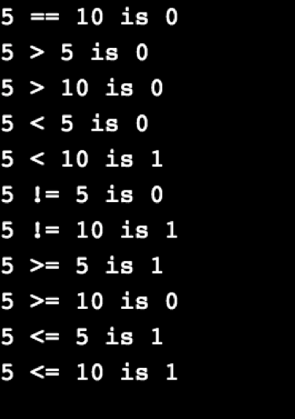
C Relational Operators
Output:
Example:

Slide 12
Outline
Arithmetic Operators
C Increment and Decrement Operators
C Relational Operators
C Logical Operators
C Bitwise Operators
C Assignment Operators
Precedence and Associativity of Operators in C

Slide 13
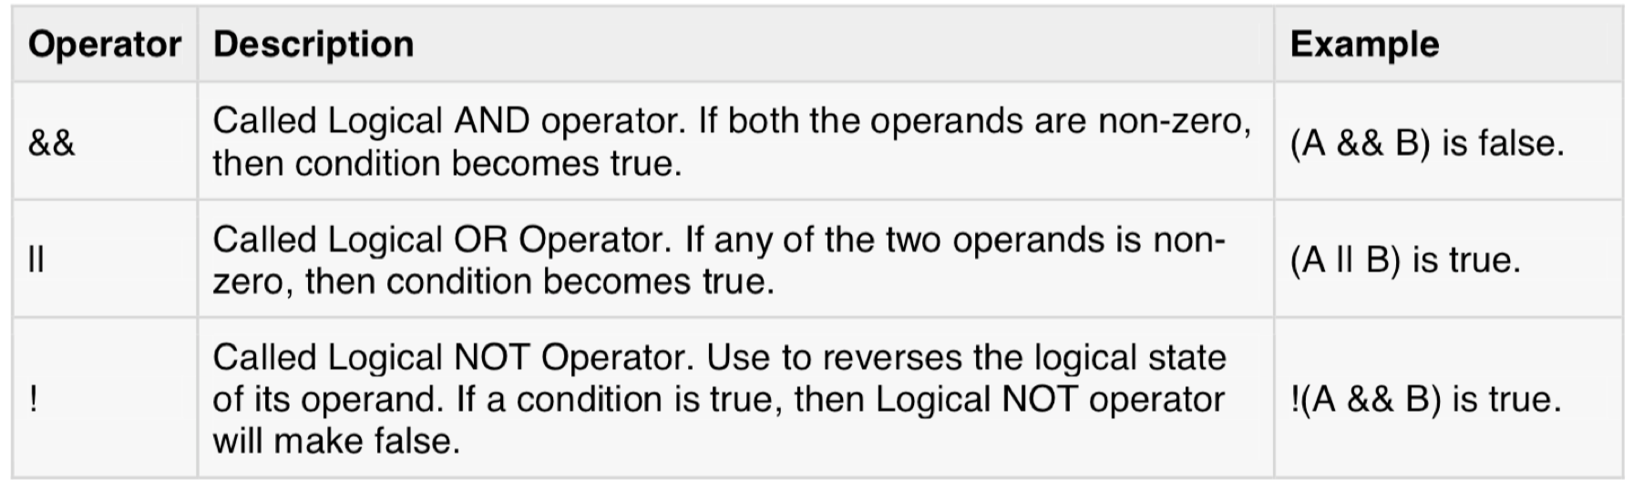
C Logical Operators
The following table shows all the logical operators supported by C language. Assume A holds 1 and variable B holds 0:

Slide 14
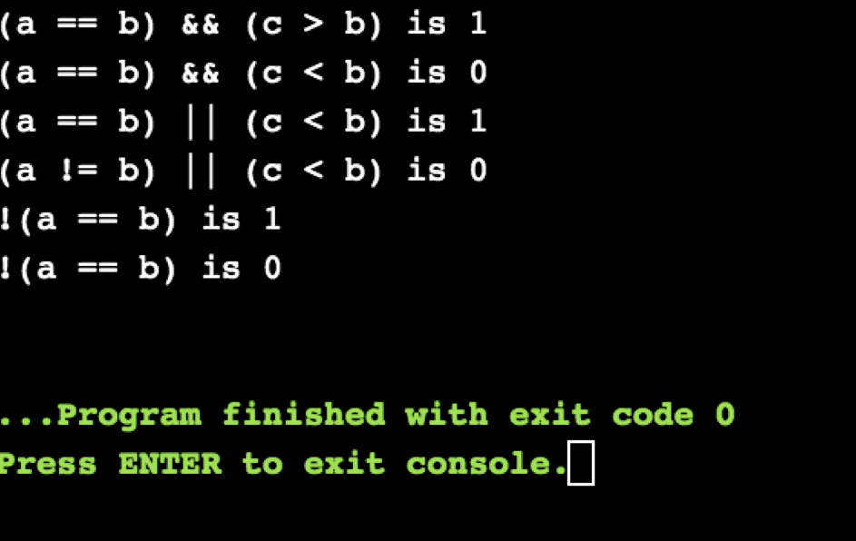
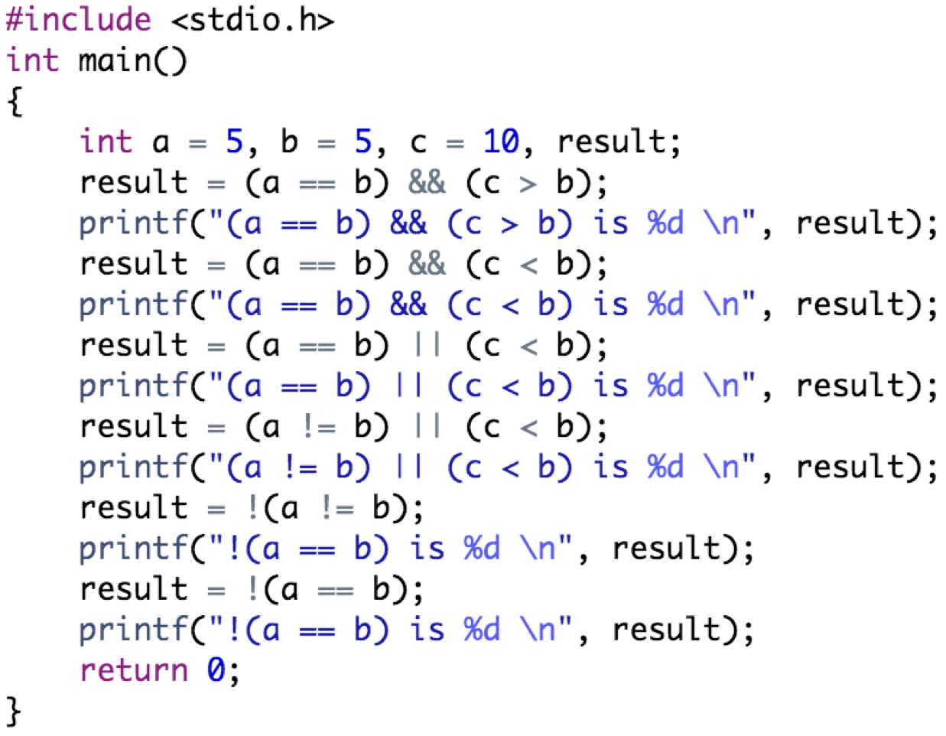
C Logical Operators
Output:
Example:
(a == b) && (c > 5) evaluates to 1 because both operands (a == b) and (c > b) is 1 (true)

Slide 15
C Logical Operators
Output:
Example:
(a == b) && (c < b) evaluates to 0 because operand (c < b) is 0 (false)

Slide 16
C Logical Operators
Output:
Example:
(a == b) || (c < b) evaluates to 1 because (a = b) is 1 (true)

Slide 17
C Logical Operators
Output:
Example:
(a != b) || (c < b) evaluates to 0 because both operand (a != b) and (c < b) are 0 (false)

Slide 18
C Logical Operators
Output:
Example:
!(a != b) evaluates to 1 because operand (a != b) is 0 (false). Hence, !(a != b) is 1 (true)

Slide 19
C Logical Operators
Output:
Example:
!(a == b) evaluates to 0 because (a == b) is 1 (true). Hence, !(a == b) is 0 (false)

Slide 20
Outline
Arithmetic Operators
C Increment and Decrement Operators
C Relational Operators
C Logical Operators
C Bitwise Operators
C Assignment Operators
Precedence and Associativity of Operators in C

Slide 21
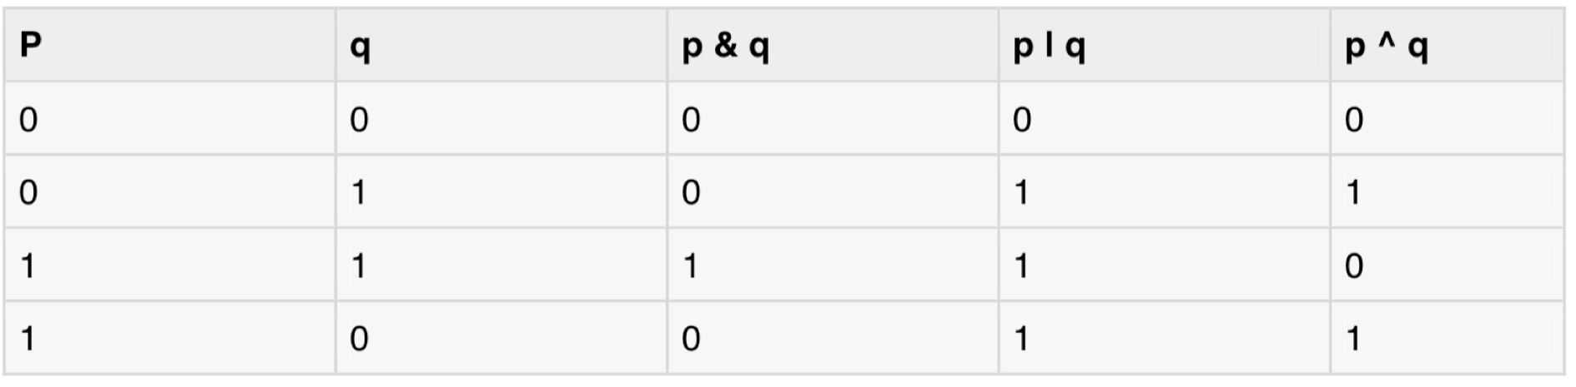
C Bitwise Operators
Bitwise operators work on bits and perform bit-by-bit operation. The truth tables for &, |, and ^ are as follows:

Slide 22
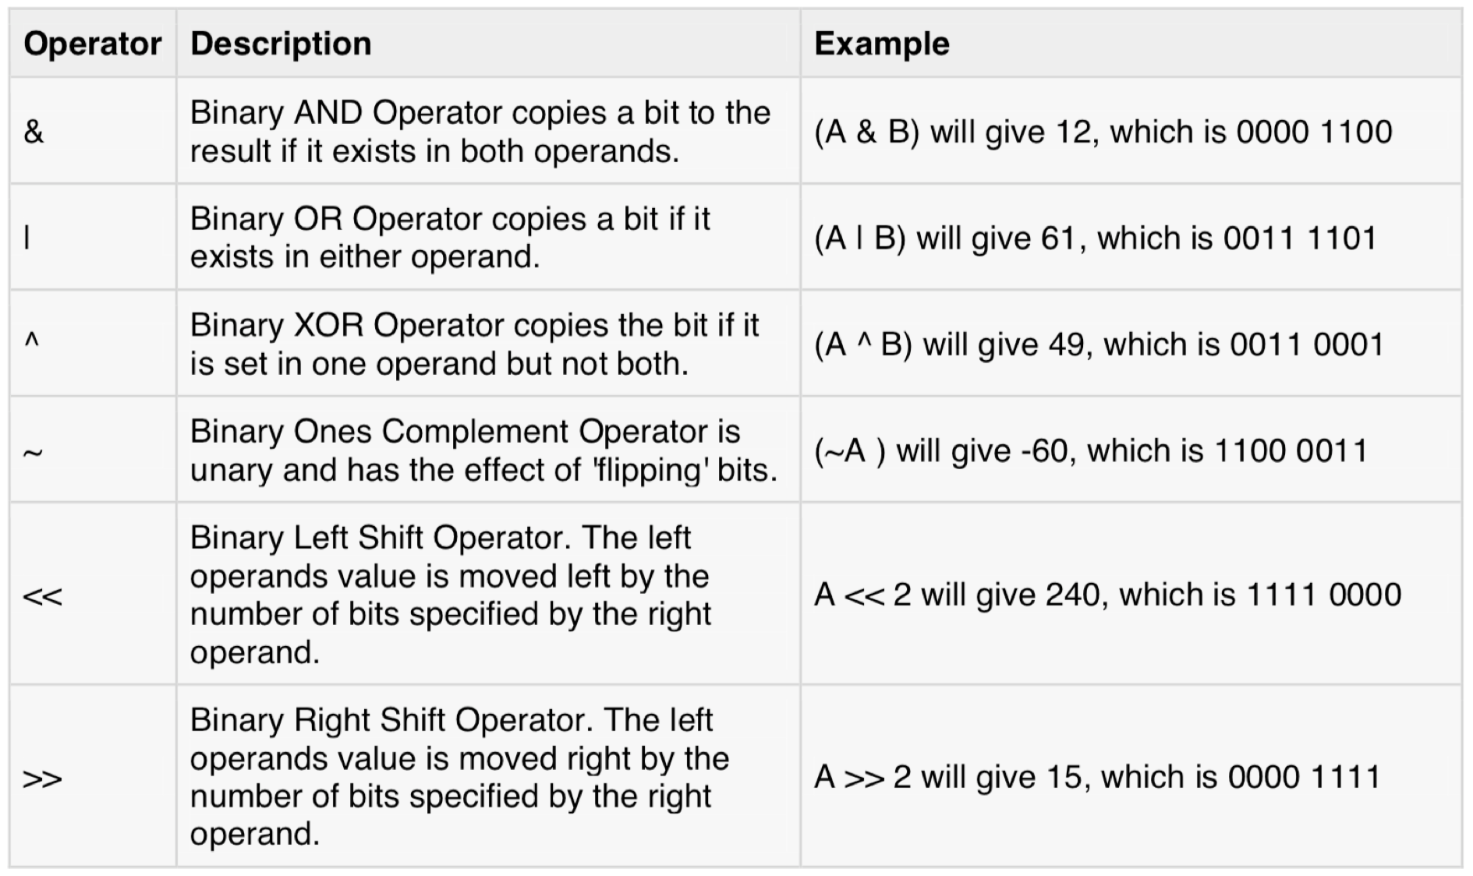
C Bitwise Operators
Assume variable A holds 60 and variable B holds 13, then:

Slide 23
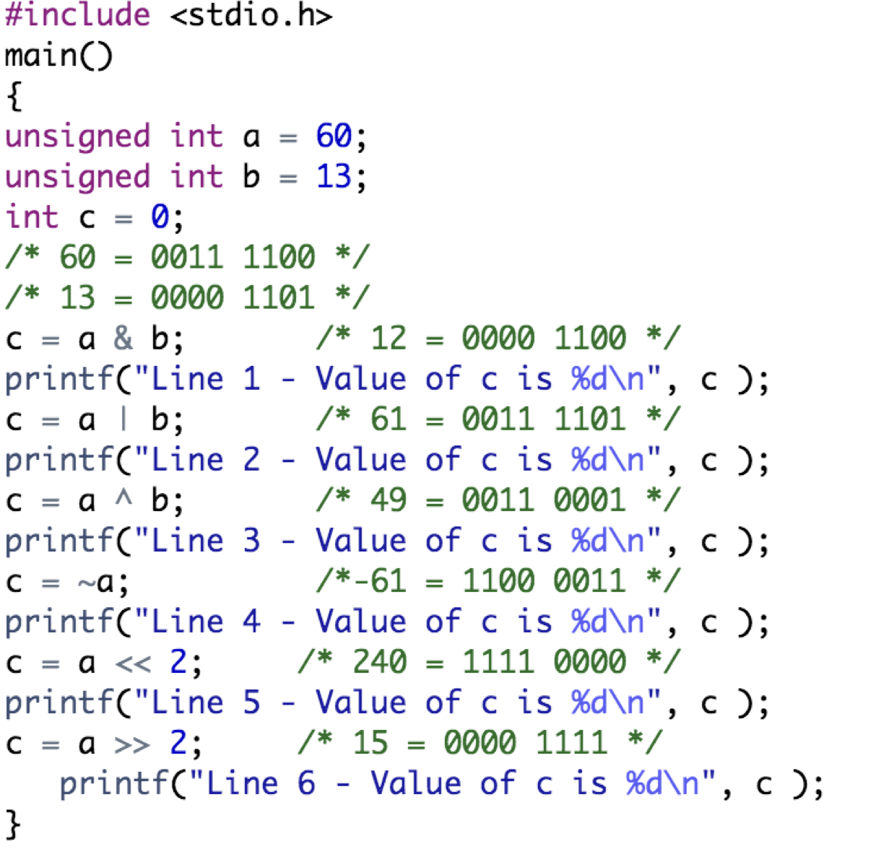
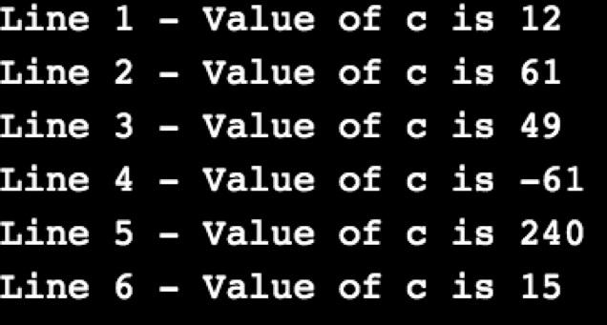
C Bitwise Operators
Output:
Example:

Slide 24
Outline
Arithmetic Operators
C Increment and Decrement Operators
C Relational Operators
C Logical Operators
C Bitwise Operators
C Assignment and Misc Operators
Precedence and Associativity of Operators in C

Slide 25
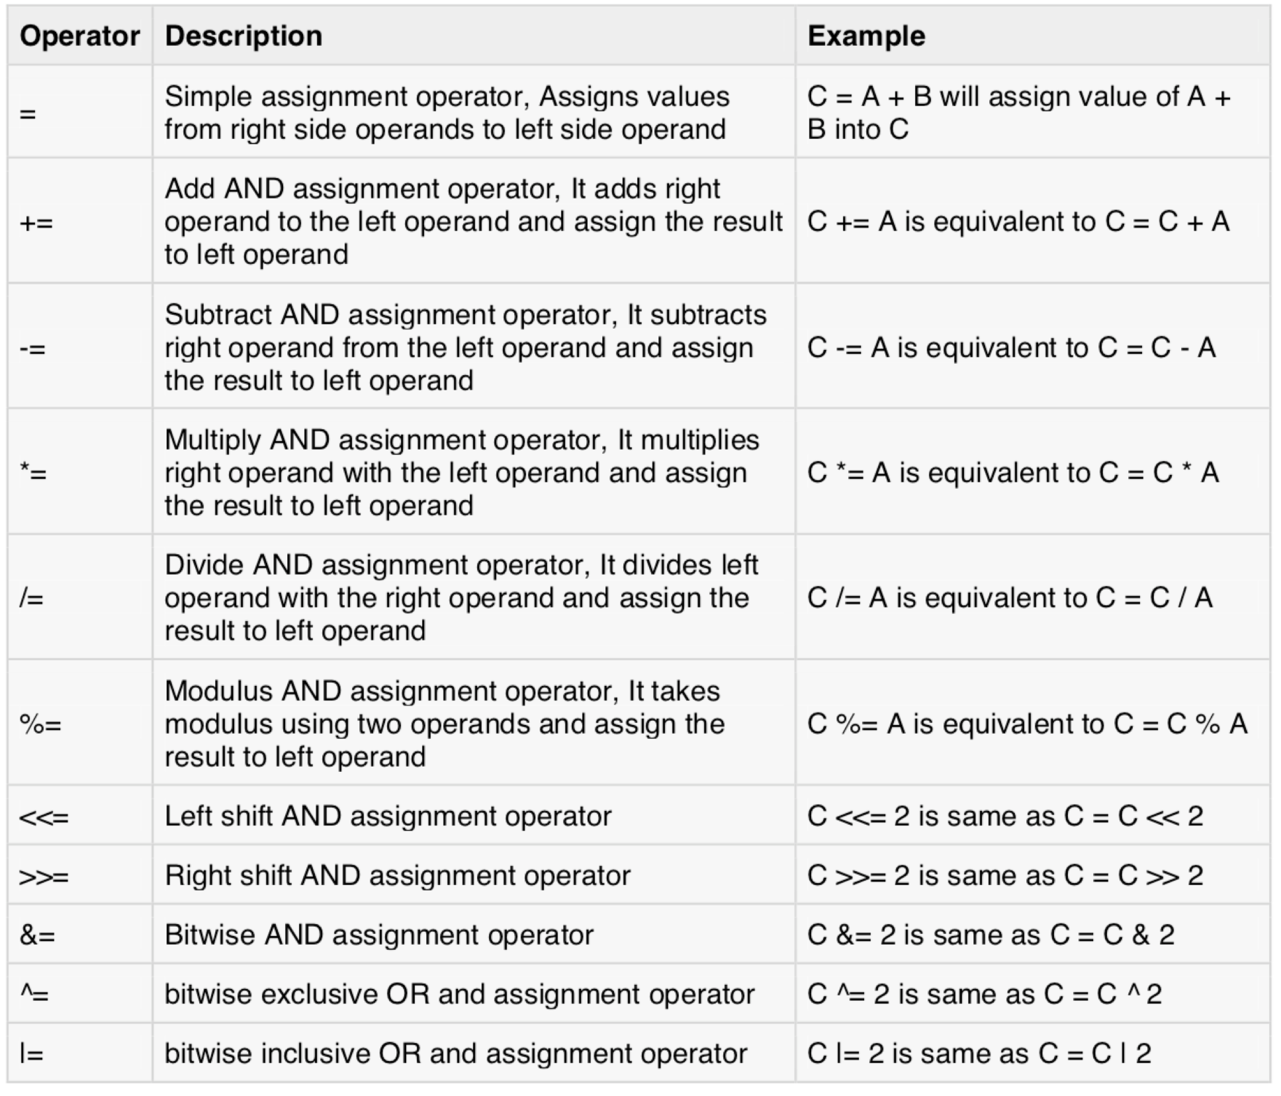
C Assignment and Misc Operators
The assignment operators supported by C are listed in the table:

Slide 26
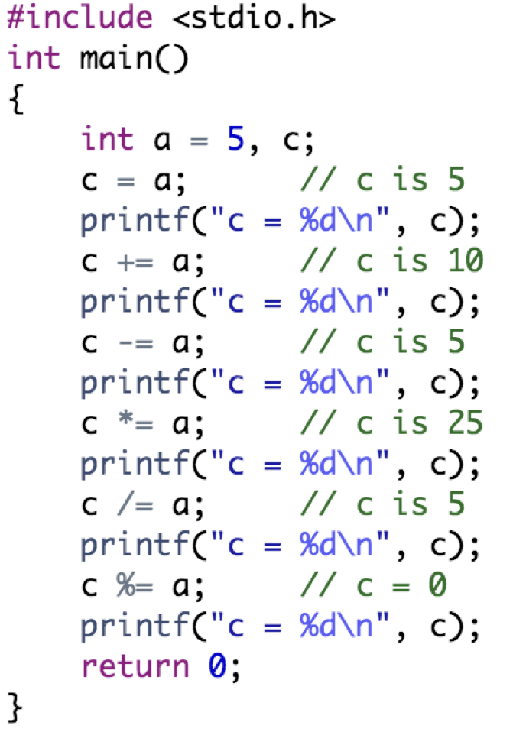
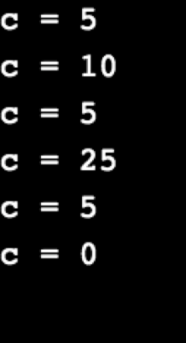
C Assignment and Misc Operators
Output:
Example:

Slide 27
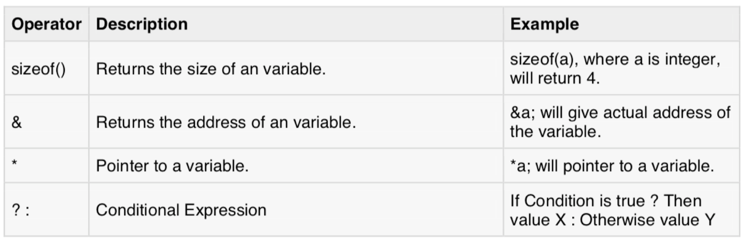
C Assignment and Misc Operators
There are few other important operators supported by C, as shown in the following table:
The sizeof is a unary operator that returns the size of data (constants, variables, array, structure, etc)

Slide 28
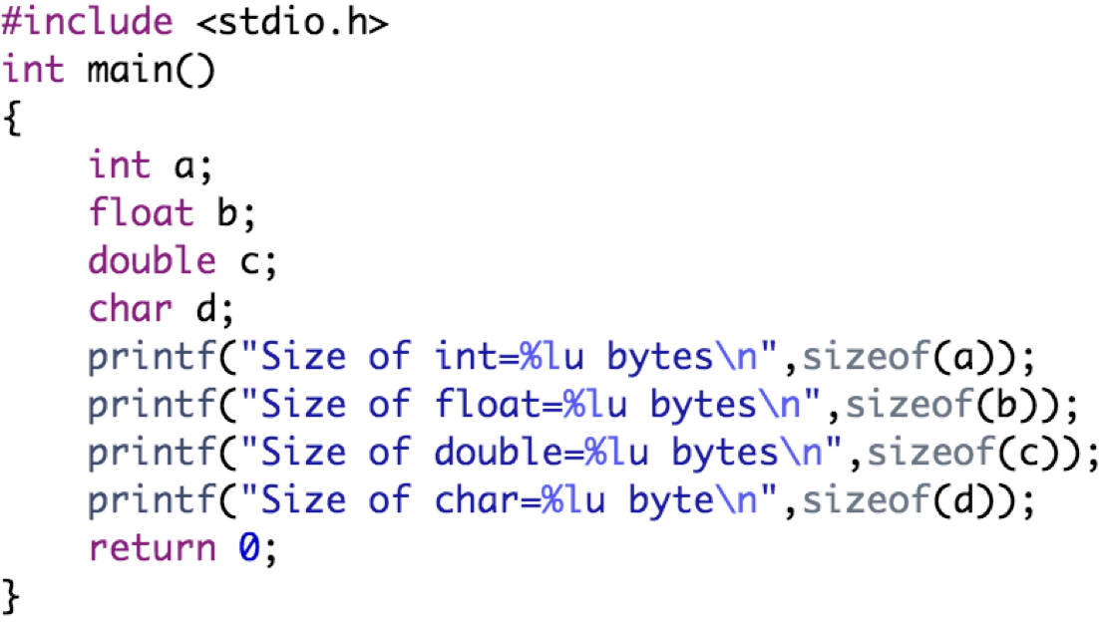
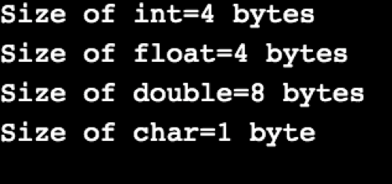
C Assignment and Misc Operators
Output:
Example:

Slide 29
Outline
Arithmetic Operators
C Increment and Decrement Operators
C Relational Operators
C Logical Operators
C Bitwise Operators
C Assignment and Misc Operators
Precedence and Associativity of Operators in C

Slide 30
Precedence of Operators in C
C language has a predefined rule of priority for the operators
This rule of priority of operators is called operator precedence
In C, precedence of arithmetic operators (*, %, /, +, -) is higher than relational operators (==, !=, >, <, >=, <=)
In C, precedence of relational operator is higher than logical operators (&&, || and !)
For example, (1 > 2 + 3 && 4) is equivalent to ((1 > (2 + 3)) && 4). That is, (2 + 3) executes first resulting into 5 then, first part of the expression (1 > 5) executes resulting into 0 (false) then, (0 && 4) executes resulting into 0 (false)

Slide 31
Associativity of Operators in C
If two operators of same precedence (priority) are present in an expression, Associativity of operators indicate the order in which they execute
For example, 1 == 2 != 3, here, operators == and != have same precedence
The associativity of both == and != is left to right, i.e, the expression on the left is executed first and moves towards the right
In C, Thus, the expression above is equivalent to : ((1 == 2) != 3), i.e, (1 == 2) executes first resulting into 0 (false), then, (0 != 3) executes resulting into 1 (true)

Slide 32
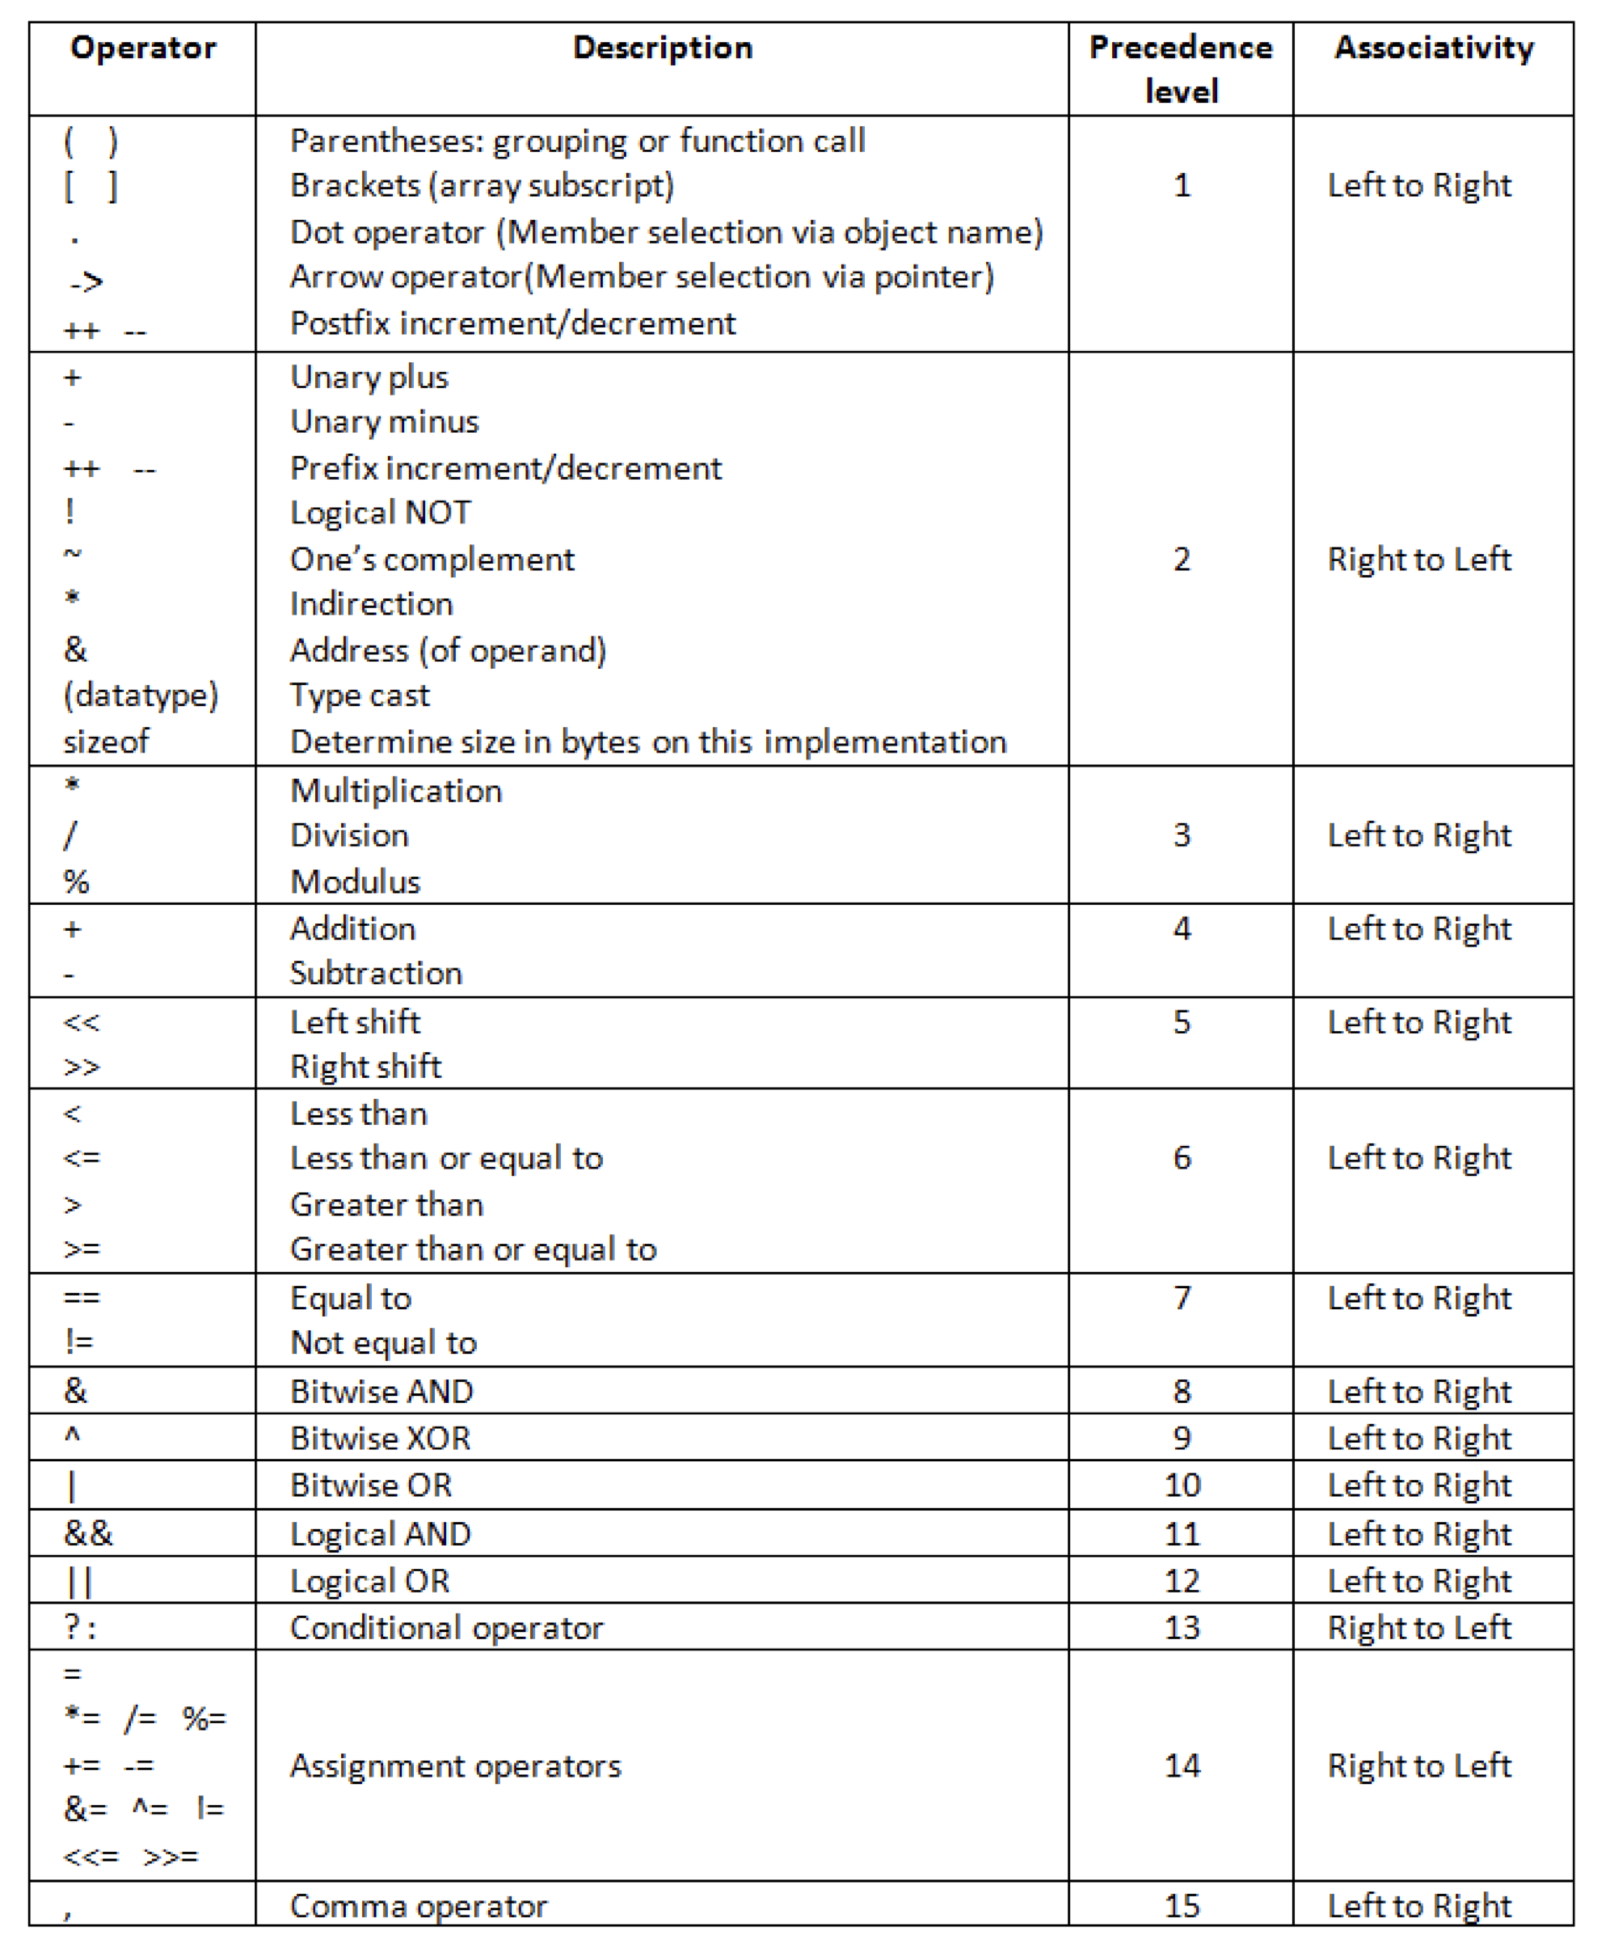
The table below shows all the operators in C with precedence and associativity

Slide 33
Practical Exercises
Write and Compile the following C programs:
Program 1:

Slide 34
Practical Exercises
Write and Compile the following C programs:
Program 2:

Slide 35
Practical Exercises
Write and Compile the following C programs:
Program 3:

Slide 36
Practical Exercises
Write and Compile the following C programs:
Program 4:

Slide 37
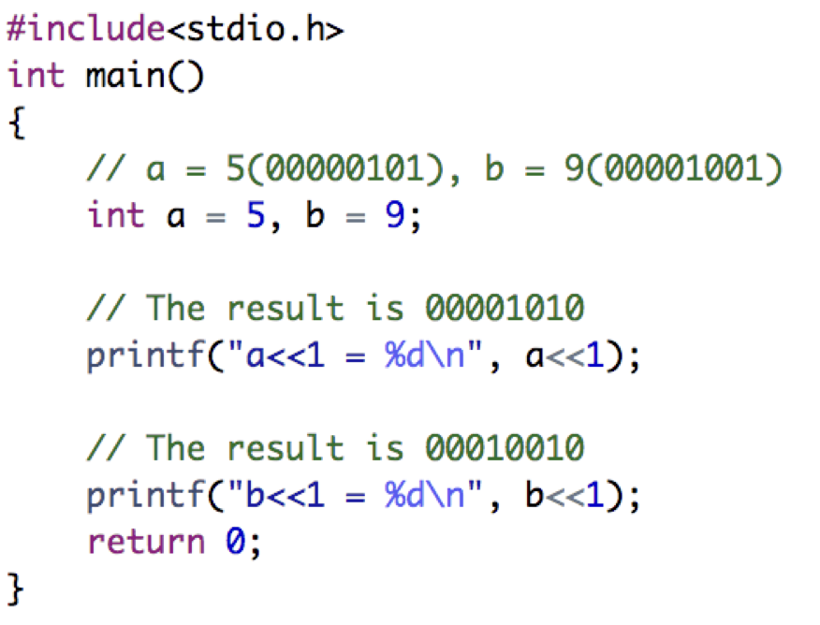
Practical Exercises
Write and Compile the following C programs:
Program 5:

Slide 38
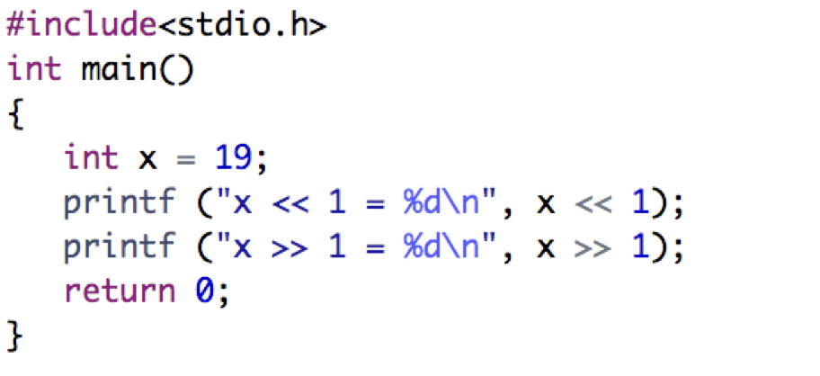
Practical Exercises
Write and Compile the following C programs:
Program 6:

